Slide 1
Loosely Coupled Semi-Direct Monocular SLAM
Reading Note

Slide 2
Introduction
Direct method(LSD-SLAM, DSO)
leverage more point which have high gradient for semi-dense map.
more robust in low-texture scenes.
without time costly feature extraction and matching.
Feature Based Method(PTAM, ORB-SLAM)
have high degree of invariance to viewpoint and illumination change.
can match over width baseline.
easy to reuse map such for loop closure.
Semi Direct(SVO)
take advantage from both direct and feature-based methods.

Slide 3
This Work
most local level
slide window for photometric BA
new frames are tracked using direct method
depth map created by projecting active points in the window
mid-level optimization
keyframe marginalized, sent to the feature-based module
extracts ORB descriptors to refines their poses using motion-only BA
most global level
pose graph optimization after loop detection
gloabal BA for all keyframes and map points

Slide 4
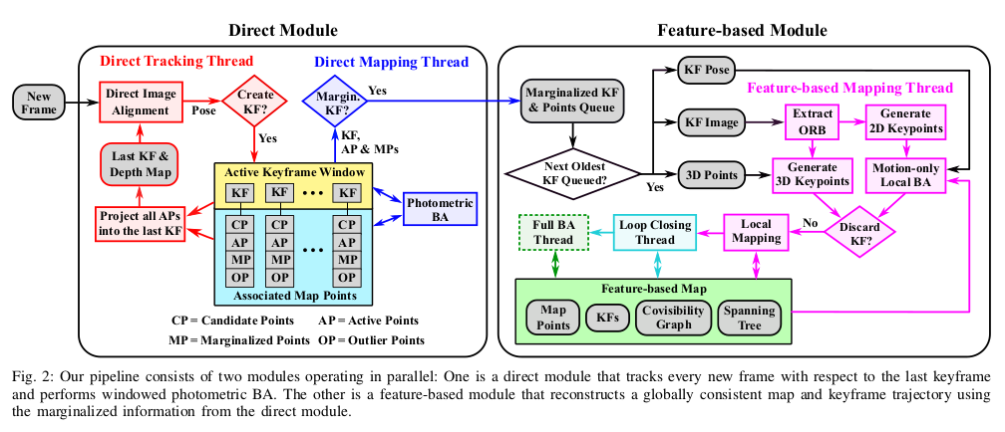
Pipeline

Slide 5


Direct Module
Windowed Photometric Bundle Adjustment
Marginalization
marginalize the least useful keyframes and points using.
Points: not observed in the latest two keyframes or host keyframe is marginalized
Keyfrmae: less than 5% points are visible in keyframes or has the highest“distance score”

Slide 6
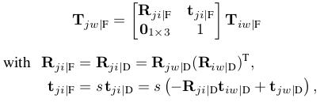
Feature Based Module
Relative Scale
because of loosely-coupled, we maintain two separate maps
The scale of two map may not converge to the same value
continuously compute the relative scale from the 30 most recent keyframes
when s is known:

Slide 7
Feature Based Module
3D keypoints Generation
map points from the direct module.
depth = mean of projected in area after extend two pixels.
A tradeoff between speed and mapping accuracy
N = 2500, if KF < 4Hz
N = 1500, if KF > 7Hz

Slide 8
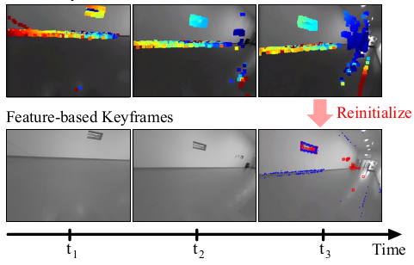
Feature Based Module
Relocation
When feature-based module fails due to insufficient matches
Loop Closing
a new thread for loop closing based on DBoW2
pose graph optimization is performed over the essential graph
Finally, a full BA is performed afterwards

Slide 9
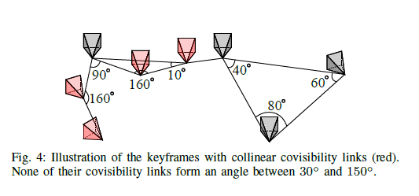
Feature Based Module
Does Feature-based Mapping Always Improve Accuracy?
feature-based mapping improves when there is loop closure or when the camera motion is mostly loopy
it causes more drift when the camera motion is mostly exploratory without loop closures
keep two versions trajectory
if there is loop closure or less
than ¼ keyframes have collinear
covisibility links use feature-based
map

Slide 10
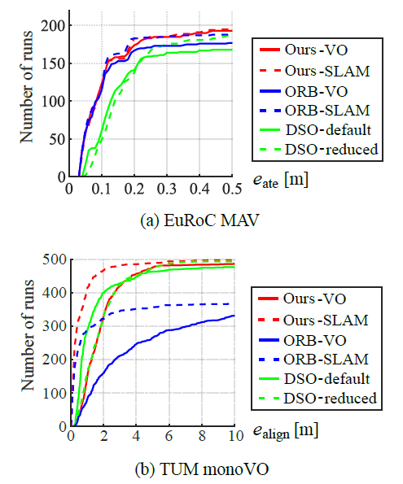
Result
ORB-VO: disable the loop closing thread
DSO-reduced: resize the input images by half
Ours-VO: use DSO-reduced and ORB-VO

Slide 11
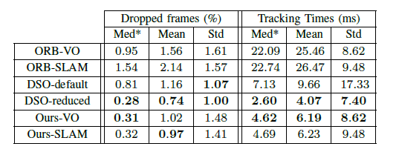
Result

Slide 12
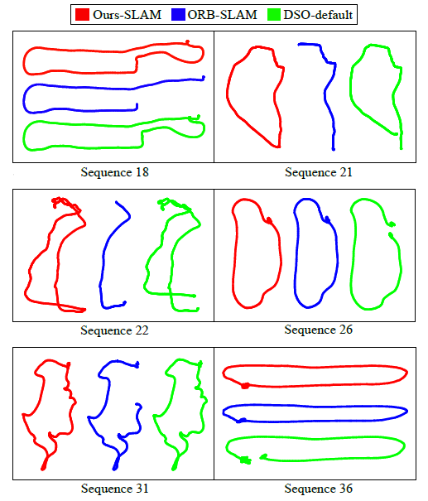
Result

